Slide 1
Input and Output Stream

Slide 2
Input and Output Stream
Input and Output (I/O) is used to process the input and produce the output based on the input.
Java uses the concept of stream to make I/O operations fast.
java.io package contains all the classes required for input and output operations.

Slide 3
Stream
A stream is a sequence of data.
In Java a stream is composed of bytes.
It's called a stream because it's like a stream of water that continues to flow.
Three streams are created for us automatically:
1) System.out: standard output stream
2) System.in: standard input stream
3) System.err: standard error

Slide 4
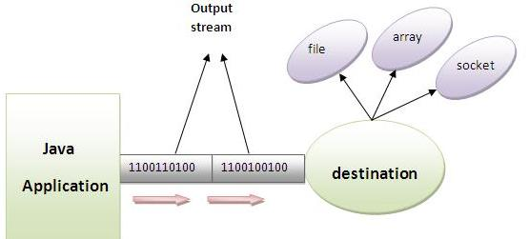
OutputStream
Java application uses an output stream to write data to a destination, it may be a file, an array, peripheral device or socket.

Slide 5
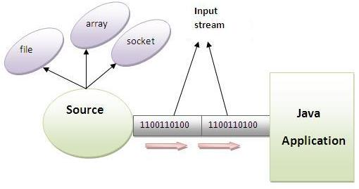
InputStream
Java application uses an input stream to read data from a source, it may be a file, an array, peripheral device or socket.

Slide 6
InputStream class
InputStream class is an abstract class.
It is the superclass of all classes representing an input stream of bytes.
Method | Description
1) public abstract int read()throws IOException: | reads the next byte of data from the input stream. It returns -1 at the end of file.
2) public int available()throws IOException: | returns an estimate of the number of bytes that can be read from the current input stream.
3) public void close()throws IOException: | is used to close the current input stream.

Slide 7
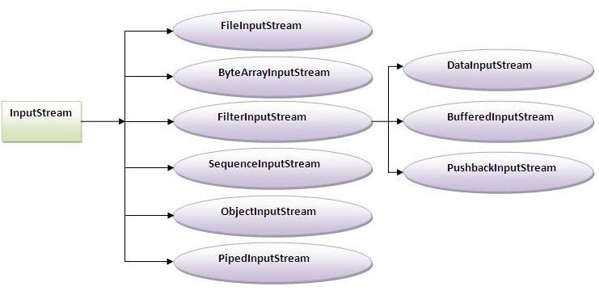
InputStream Hierarchy

Slide 8
OutputStream class
OutputStream class is an abstract class.
It is the superclass of all classes representing an output stream of bytes.
An output stream accepts output bytes and sends them to some sink.
Method | Description
public void write(int)throws IOException: | is used to write a byte to the current output stream.
public void write(byte[])throws IOException: | is used to write an array of byte to the current output stream.
3) public void flush()throws IOException: | flushes the current output stream.
4) public void close()throws IOException: | is used to close the current output stream.

Slide 9
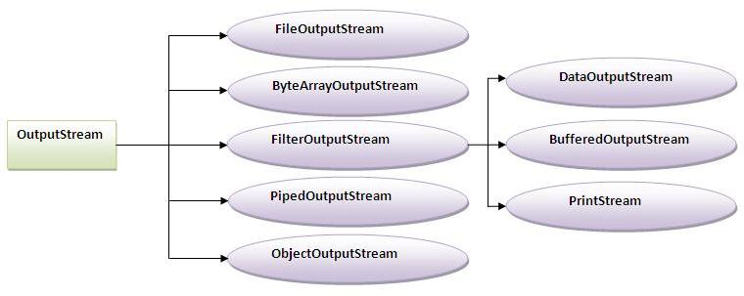
OutputStream Hierarchy

Slide 10
InputStream class
InputStream class is an abstract class.
It is the superclass of all classes representing an input stream of bytes.
Method | Description
1) public abstract int read()throws IOException: | reads the next byte of data from the input stream. It returns -1 at the end of file.
2) public int available()throws IOException: | returns an estimate of the number of bytes that can be read from the current input stream.
3) public void close()throws IOException: | is used to close the current input stream.

Slide 11
InputStream Hierarchy

Slide 12
FileInputStream and FileOutputStream (File Handling):
FileInputStream and FileOutputStream classes are used to read and write data in file.
In another words, they are used for file handling in java.

Slide 13
FileOutputStream class:
A FileOutputStream is an output stream for writing data to a file.
If you have to write primitive values then use FileOutputStream.
Instead, for character-oriented data, prefer FileWriter.
But you can write byte-oriented as well as character-oriented data.

Slide 14


Slide 15
Thank You

